Slide 1

Wine Recommender app
Team - Crosstrainers

Slide 2


Project Overview
Data Exploration
Team introduction &
Problem Statement
ShinyApp
Datasets Used
Data Clealing
Data Summary
Data deep dive
Notes:
Moving forward

Slide 3
Project Overview
Data Exploration
Team introduction &
Problem Statement
ShinyApp
Datasets Used
Data Clealing
Data Summary
Data deep dive
Notes:
Moving forward

Slide 4





Team introduction - Crosstrainers
Deepankar Singh
Soujanya S
Saumya Bharti
Rahul Madhu
Keerthi Pullela

Slide 5

Problem Statement
Who are our users?
Millions and millions of people around the globe consume ~290 million hectoliter of wine annually
Stakeholders
Wine enthusisasts
Sommeliers
Wine tourism agencies
Why do they need this?
This recommender aims to provide a platform to all these consumers to identify different variety of wines based on the description of their preferred wine.
Notes:
© Copyright Showeet.com – Free PowerPoint Templates

Slide 6
Project Overview
Data Exploration
Team intro &
Problem Statement
ShinyApp
Datasets Used
Data Clealing
Data Summary
Data deep dive
Notes:
Moving forward

Slide 7






Data Exploration – Data Summary
Data Source: (Data Keywords)https://github.com/atsigman/winedapp/blob/master/data/wines_df.csv
(Data file) (https://www.kaggle.com/sudhirnl7/wine-recommender/data
Data Overview
~118K Products
51 Countries
~700 Varieties
Price
$4 to $3300
(Median:$25; Mean:$35.36)
Points
80 to 100
(Median:88; Mean:88.45)
~16.7k
Wineries

Slide 8
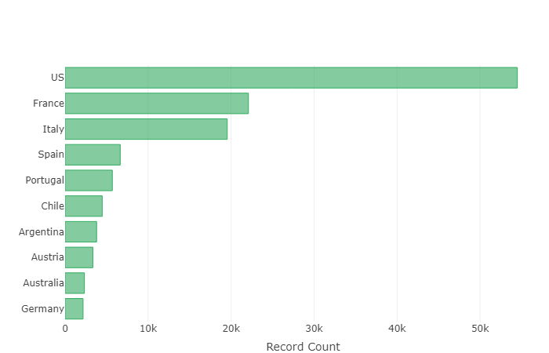
Data Exploration – Top 10 Countries
Insights
USA has the highest coverage in the data with ~54.5k records
As expected the data set is predominated by
Americas (USA, Chile & Argentina)
South Europe (France, Italy, Spain,Portugal and Germany)
We used the plotly library instead of the standard ggplot2 for the graph here as it provides better visuals and can provide ability to manipulate charts within the graphs

Slide 9
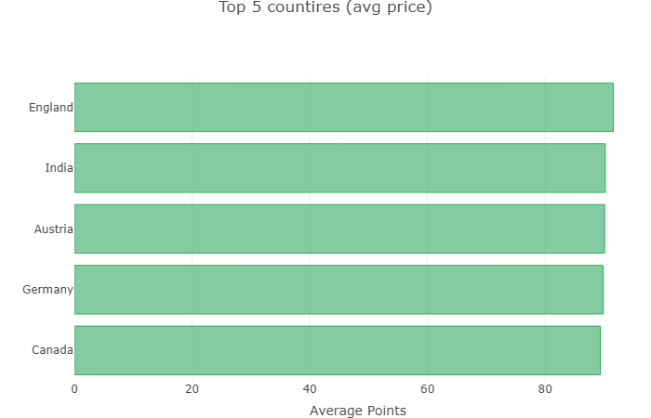
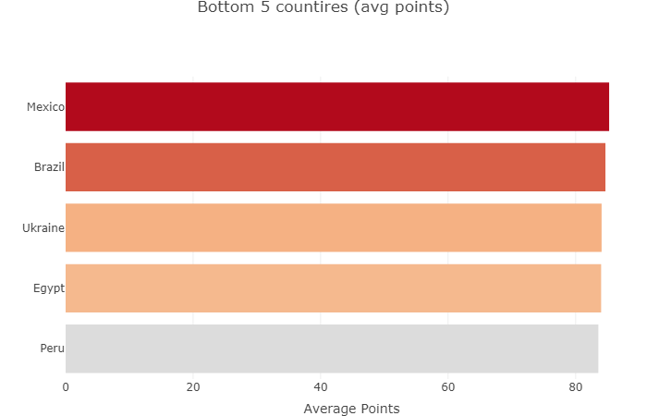
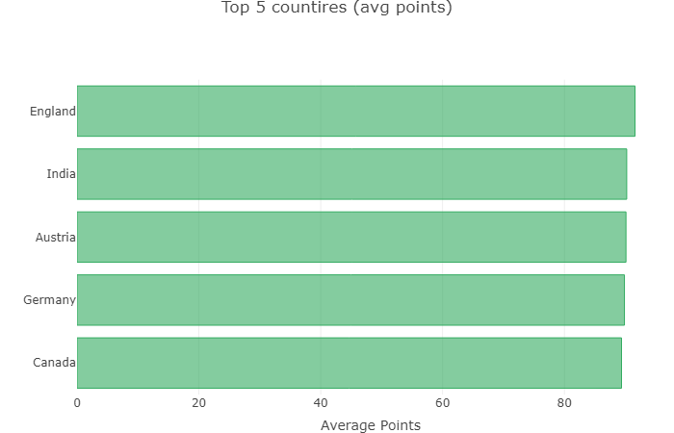
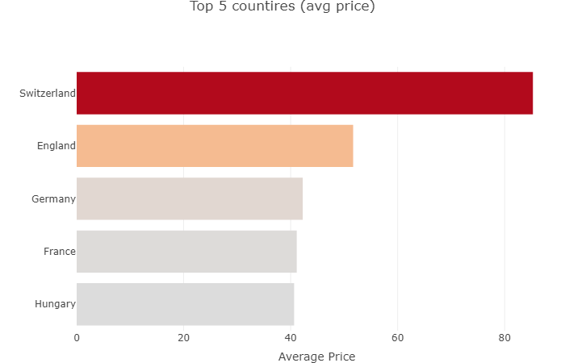
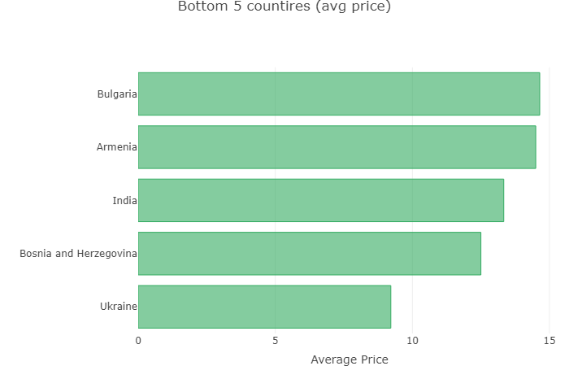
Data Exploration – Top and bottom countries as per average price and points using plotly
Insights
Points are the ratings provided by renowned sommeliers (tasters in the dataset)
England has the highest average points and the second highest average price. One could say that they are worth it!
Average prices are higher in Europe as all top five countries are from Europe
Surprise! Surprise! Neither of France, Spain, Italy and US are amongst top avg points rating
India is provides more value for money

Slide 10
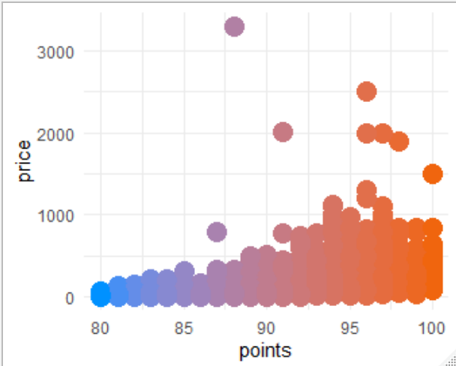
Data Exploration – Correlation between price and rating (points)
Insights
There is a slight correlation between price and points provided by tasters
As the the rating (points) increase one can see a slight increase in price
This is minimized by countries that provide value for money wines (for example: India)

Slide 11
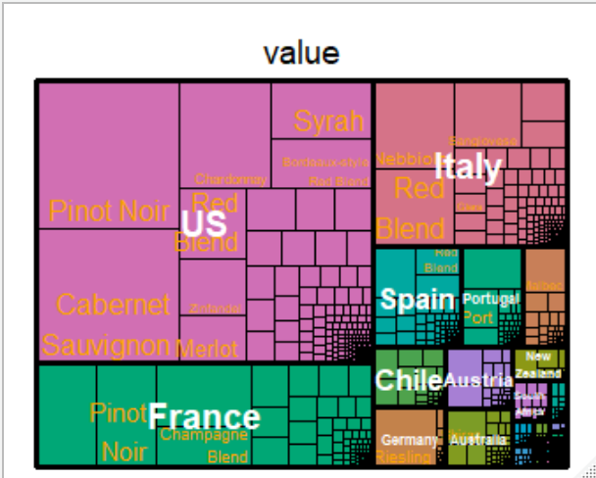
Data Exploration – Treemap for country and their variety of wine by price
Insights
This provides and insight into how are the prices distributed for each country and the varieties they offer
US offers a great range of wine types that vary in quality and price
France as expected is dominated by Pinot Noir and Champagne Blend

Slide 12
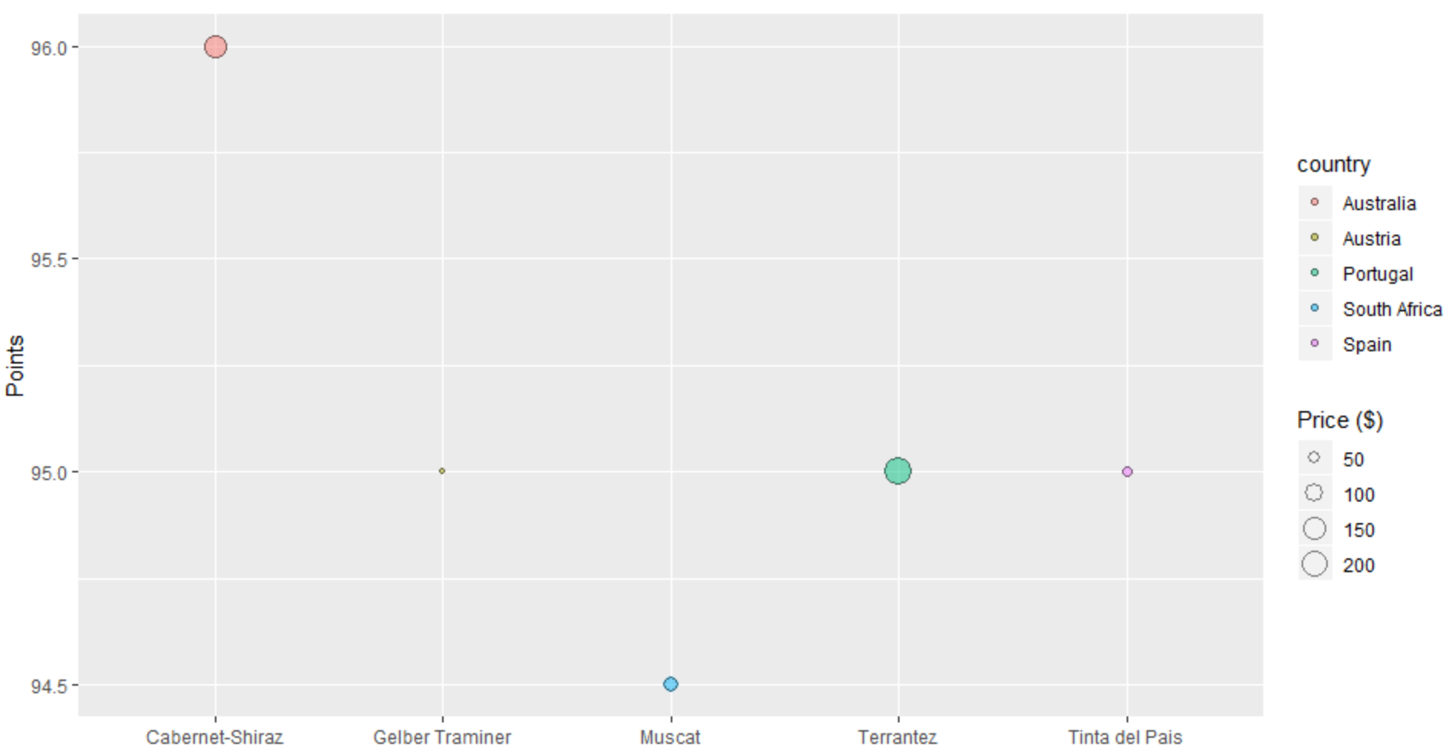
Data Exploration – Overall summary of price, average rating, country and variety
Insights
We have talked about prices, average ragting, country and variety in silos and combinations but never as a whole
Here we can see the how the varieties with top 5 average ratings are doing on price and which country(ies) they are from
The best rated variety “Cabernet-Shiraz” has a somewhat high-priced compared to the rest here but proves to be value for money. Go Australia!!

Slide 13
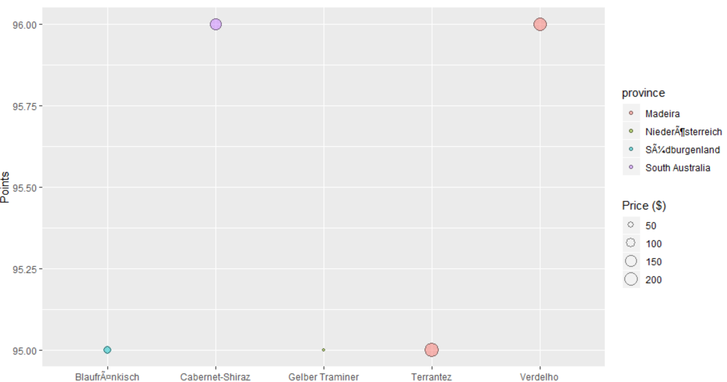


Data Exploration – Lets look at the same metrics but this on the basis of province
Insights
We all know how important the location/province is in understanding a wine
We can see how looking at province instead of the whole country can change the standings
We see 2 new entries of wine varieties from lower and eastern wine regions of Austria
This confirms the importance of knowing the province from where the wine is originating instead of just looking at coutntry

Slide 14
Project Overview
Data Exploration
Team intro &
Problem Statement
ShinyApp
Datasets Used
Data Clealing
Data Summary
Data deep dive
Notes:
Moving forward

Slide 15
Wine recommendation – Suggesting similar wines based on user input
Insights
Recommmender System
We sourced a text file ‘common_words_and_bigrams.txt’ to assimilate words used most while describing wines.
We used the column description of the dataset to tokenize the string into separate words to compare with aforementioned file
We then modified the description variable to only include words which are common with the common words text
For the wines the user enters, the algo will pick descriptions of those wines and evaluated which other wines had the same descriptions occurring most. The top ones were chosen as suggestions.
Data File
Keywords File
Replace description with key words
AppUI
Identify keywords of selected wine
Recommend other wines with same keywords

Slide 16
References
STHA: http://www.sthda.com/english/wiki/word-cloud-generator-in-r-one-killer-function-to-do-everything-you-need
Kaggel: (https://www.kaggle.com/sudhirnl7/wine-recommender/data
Statmethods: https://www.statmethods.net/graphs/bar.html
R-Graph gallery: https://www.r-graph-gallery.com/bubble-chart.html
GitHub: https://github.com/jordanbean/WineRecommender
https://rstudio.github.io/shiny/tutorial/

Slide 17
Off to UI

Slide 18
Thank You.
Notes:
Illustrated by pikisuperstar Character design by Freepik

